Slide 1

NRI INSTITUTE OF INFORMATION SCIENCE AND TECHNOLOGY, BHOPAL
MAJOR PROJECT PRESENTATION ON
A VERSION CONTROL SYSTEM USING RUST
Submitted by
PURUSHOTTAM SINGRAM (0115CS211083)
MONU YADAV (0115CS211068)
VIVEK GUPTA (0115CS211127)
VISHAL KUMAR (0115CS211125)
Under the supervision of
Prof. Vaibhav Patel
CSE, NIIST Bhopal
Department of Computer Science & Engineering
Session: Jan to Jun 2025

Slide 2
CONTENT
Introduction
Problem identification
Advantage of proposed solution
Study of existing system
Feasibility analysis
Bottleneck of existing system
Work flow (technical stack)
Screenshots & prototype
Limitations
Proposed solution
Conclusion

Slide 3
INTRODUCTION
A Version Control System (VCS) is a software tool that manages and tracks changes to source code over time. It enables collaboration by allowing multiple developers to work on a project simultaneously without conflict. VCS also supports branching, merging, and rollback to previous versions, ensuring efficient and secure development workflows.

Slide 4
INTRODUCTION
Chak is a lightweight, fast, and modern version control system (VCS) written in Rust, designed to simplify and enhance collaboration among developers. It provides core version control features such as commit history, branching, merging, and remote sync, while offering a cleaner and more intuitive developer experience.

Slide 5
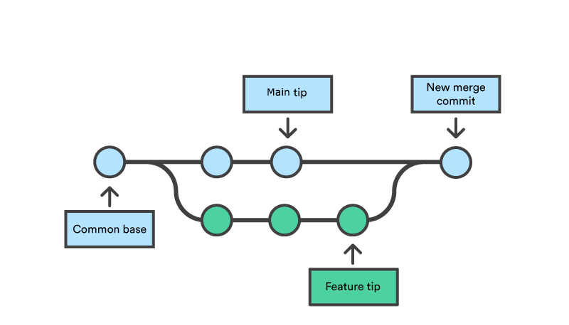
PROBLEM IDENTIFICATION
git cherry-pick vs git rebase
git revert vs git reset
git stash pop vs git stash apply
Traditional VCSs like Git come with the following challenges:
Steep learning curve for beginners
Complex command-line interface
Merge conflicts and poor tooling around them
Slow performance in large repositories
Limited built-in security mechanisms
Difficult rollback/undo mechanisms

Slide 6
PROPOSED SOLUTION
Chak addresses these by:
Building a simplified command set
Ensuring fast operations via Rust's performance
Adding better error messages and guidance
Supporting cryptographic commit validation
Creating an optional lightweight UI for visual users

Slide 7
ADVANTAGE OF PROPOSED SOLUTION
User-Friendly CLI with simple syntax
Blazing-fast performance due to Rust
Secure by Design, with future support for encrypted histories
Modular Architecture for extending features
Better onboarding experience for students and newcomers

Slide 8
STUDY OF EXISTING SYSTEM
Git, Mercurial, and Subversion dominate the space, but:
Git requires mastering dozens of commands
Errors are not descriptive
GUIs are inconsistent across platforms
Collaboration tools are external (e.g., GitHub, GitLab)

Slide 9
FEASIBILITY ANALYSIS
Technical Feasibility
Rust provides the necessary tools to build performant, memory-safe CLI applications.
Operational Feasibility
Developers with basic CLI knowledge can use Chak immediately.
Economic Feasibility
As an open-source tool, Chak reduces cost barriers for individuals and institutions.

Slide 10
BOTTELNECK OF EXISTING SYSTEM
Bottleneck of Existing System
Merge conflict complexity
Error-prone rollback
Performance issues on scale
Poor error feedback
Complex branching models

Slide 11
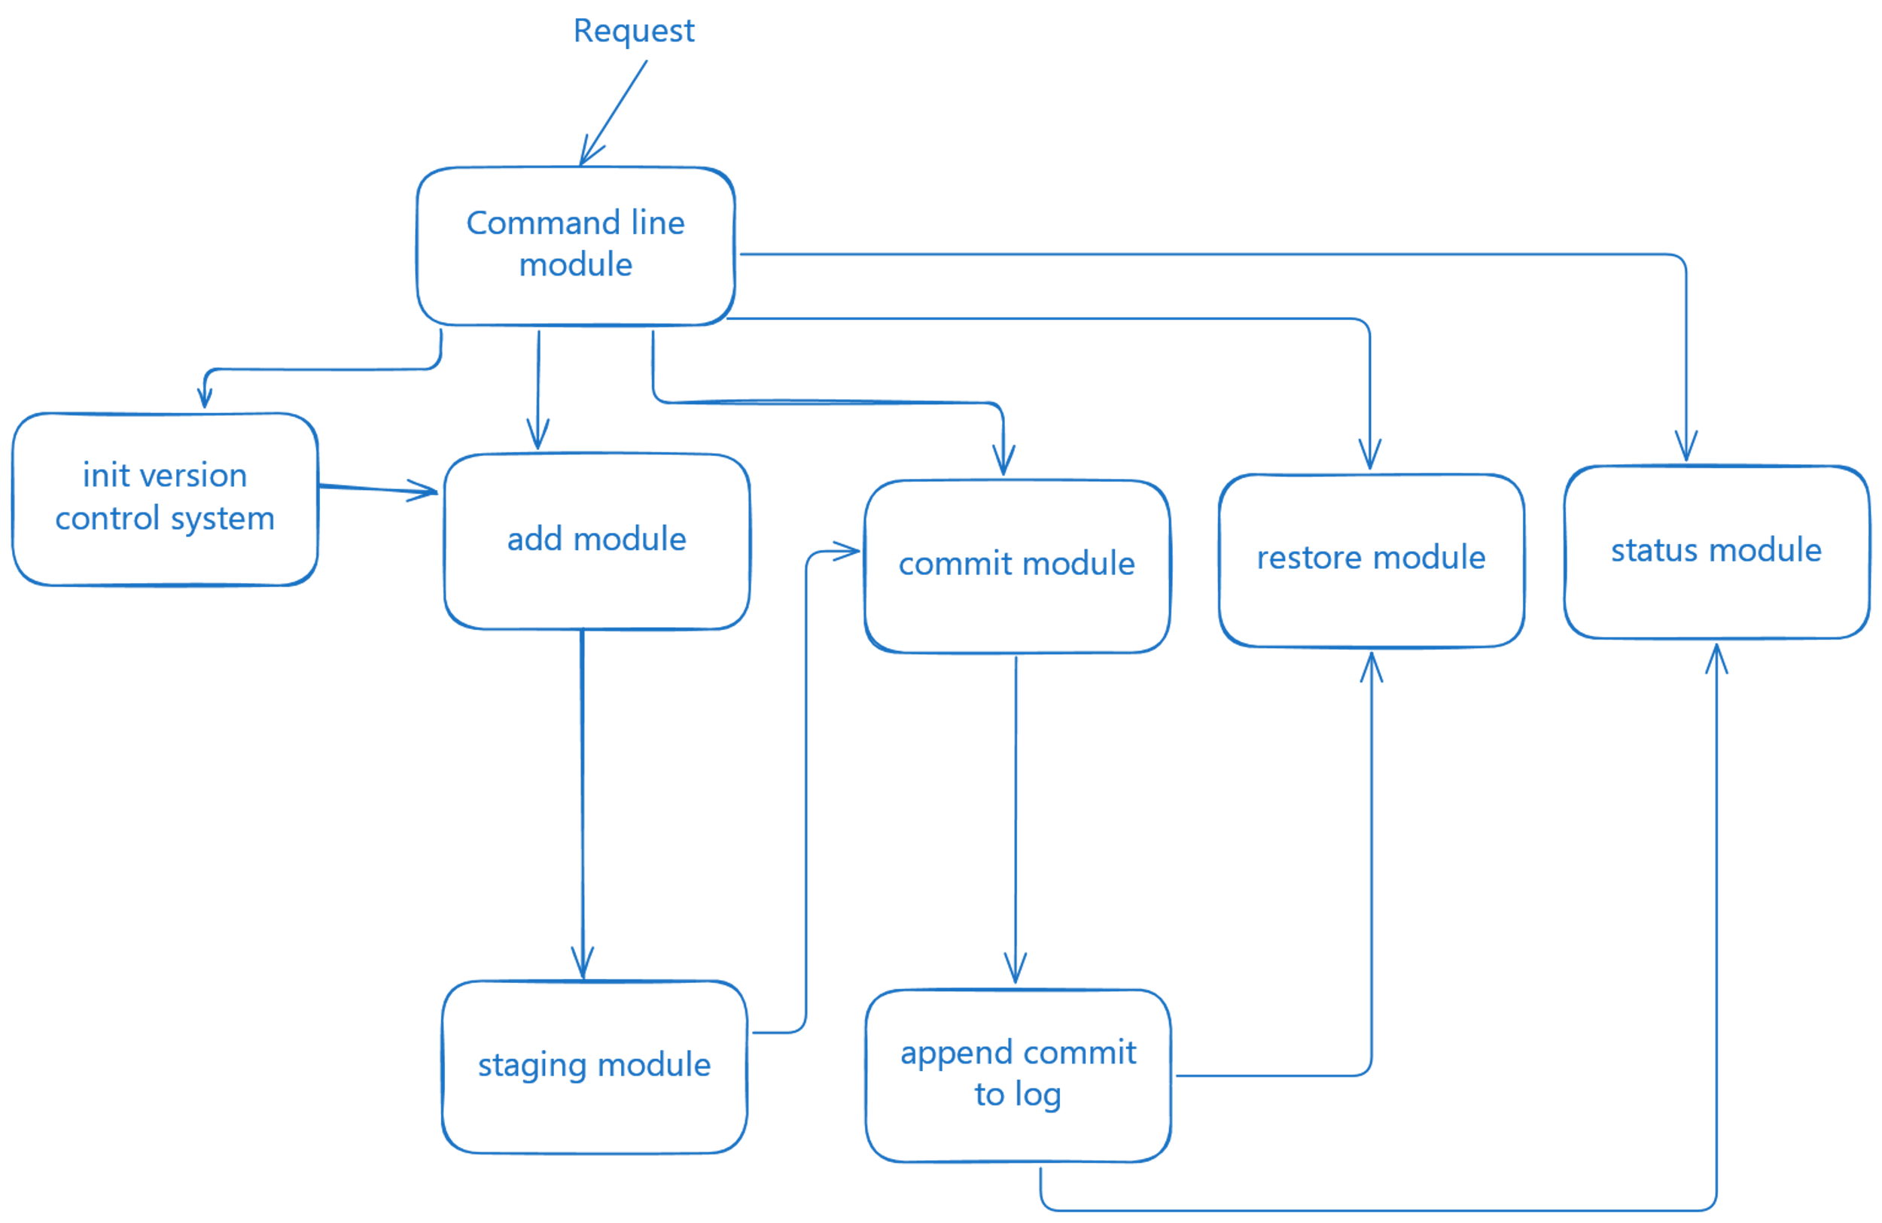
SCREENSHOTS & PROTOTYPE – COMMANDLINE MODULE
Commandline interface (main entry point )
Based on request chak system perform different operations

Slide 12
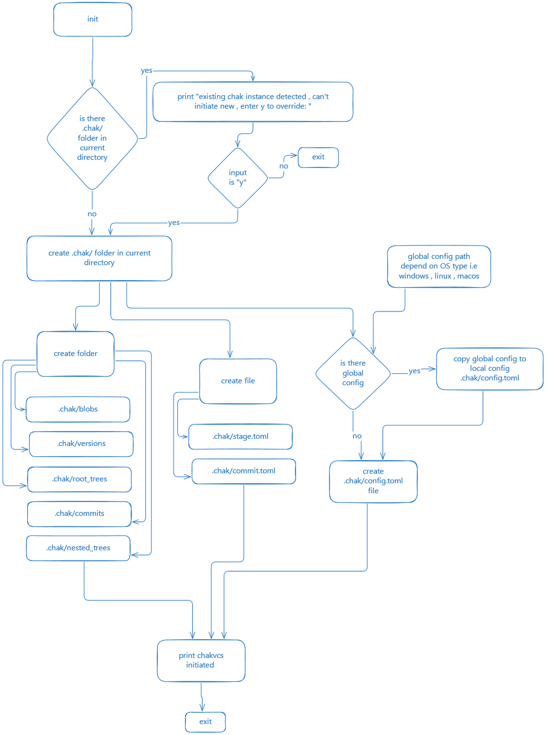
SCREENSHOTS & PROTOTYPE – INIT MODULE
INTIALIZATION OF CHAK VERSION CONTROL SYSTEM

Slide 13
SCREENSHOTS & PROTOTYPE – INIT MODULE
Checks that previously .chak folder exist or not, if exist asks for override , if not exist creates .chak/ folder (where all the chak version configuration)

Slide 14
SCREENSHOTS & PROTOTYPE – INIT MODULE
Checks that : is there any global configuration for chak or not ;
If global config exist then
Global config merged into local config

Slide 15
SCREENSHOTS & PROTOTYPE – INIT MODULE
Creates all essential folders and files inside .chak/ folder , prints "chakvcs initiated " and exit

Slide 16
SCREENSHOTS & PROTOTYPE – INIT MODULE
prints "chakvcs initiated " and exit

Slide 17
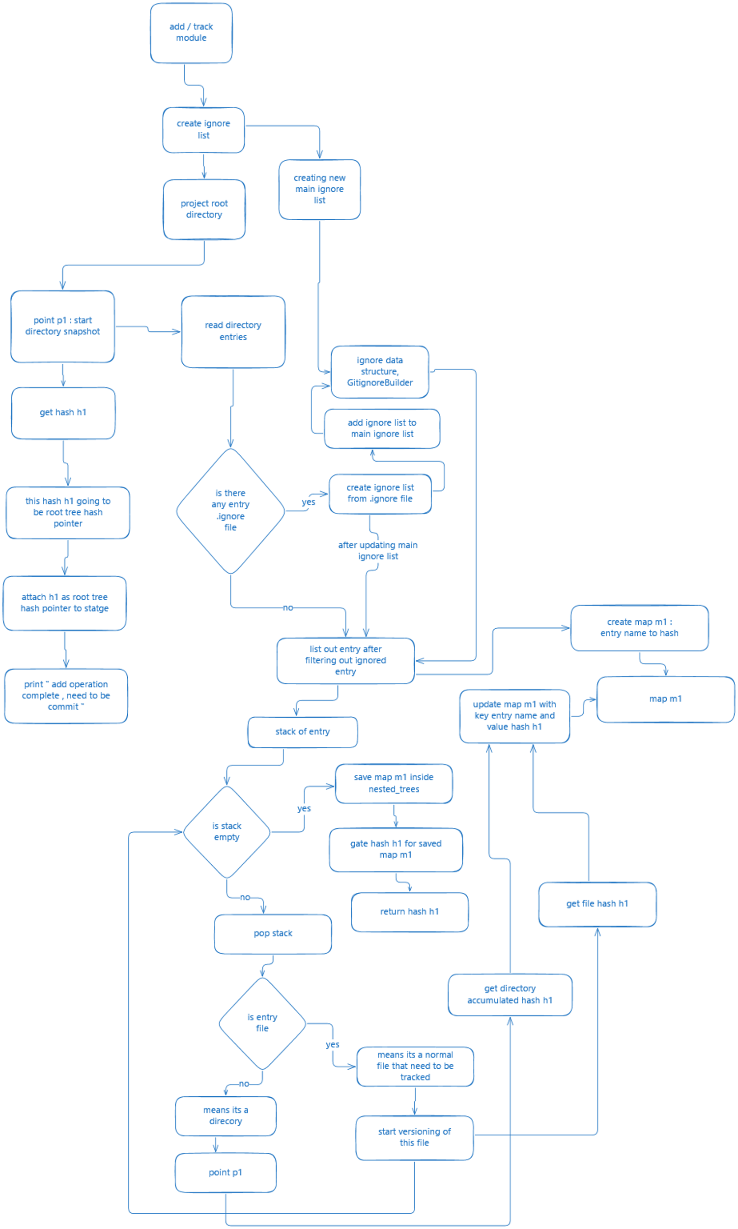
SCREENSHOTS & PROTOTYPE – ADD/TRACKING MODULE
CRUX OF CHAK VERSION CONTROL SYSTEM: SNAPSHOT MODULE OR TRAKCING MODULE

Slide 18
SCREENSHOTS & PROTOTYPE – ADD/TRACKING MODULE
Tracking module starts by creating ignore list (gitignorebuilder)

Slide 19
SCREENSHOTS & PROTOTYPE – ADD/TRACKING MODULE
Tracking module starts by creating ignore list (gitignorebuilder)

Slide 20
SCREENSHOTS & PROTOTYPE – ADD/TRACKING MODULE
Creating a point or functions point from where we start recursive tracking

Slide 21
SCREENSHOTS & PROTOTYPE – ADD/TRACKING MODULE
We will update our ignore list if there exist .ignore file inside sub directory

Slide 22
SCREENSHOTS & PROTOTYPE – ADD/TRACKING MODULE
We will create a map that contains key entry name (file / folder name) and value the hash of these (folder / files )
So that at the end we will get one hash from this map and will return to parent function

Slide 23
SCREENSHOTS & PROTOTYPE – ADD/TRACKING MODULE
And it would be easy for parent function to get a unique hash for this subdirectory

Slide 24
SCREENSHOTS & PROTOTYPE – ADD/TRACKING MODULE
We have created a stack as a list of entry (files / folder)
For each entry of stack we check its folder or file

Slide 25
SCREENSHOTS & PROTOTYPE – ADD/TRACKING MODULE
If it’s a file then we start versioning of this file and get hash h1 and update map1

Slide 26
SCREENSHOTS & PROTOTYPE – ADD/TRACKING MODULE
For folder we call this recursive functions

Slide 27
SCREENSHOTS & PROTOTYPE – ADD/TRACKING MODULE
At the end we will get one top hash tree pointer we call it root tree pointer
This root tree pointer resprent all the abstract structure of project

Slide 28
SCREENSHOTS & PROTOTYPE – ADD/TRACKING MODULE
We have attached root pointer to stage so that it will be easy for commit to get an entry that is root tree pointer in stage

Slide 29
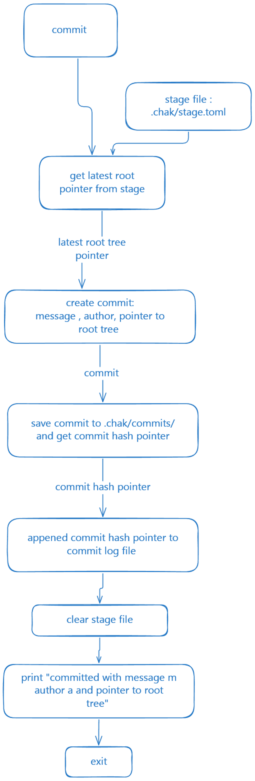
SCREENSHOTS & PROTOTYPE – COMMIT MODULE
COMMIT is a way to secure changes of proejct with message

Slide 30
SCREENSHOTS & PROTOTYPE – COMMIT MODULE
Commit needs a root tree pointer this is backup entry point if developer wants to reset code this helps to restore

Slide 31
SCREENSHOTS & PROTOTYPE – COMMIT MODULE
Creating commit using user provided messgae , user name and pointer to root tree pointer

Slide 32
SCREENSHOTS & PROTOTYPE – COMMIT MODULE
Saving commit we will get commit hash pointer , we will attach this pointer to commit log file for future reference

Slide 33
SCREENSHOTS & PROTOTYPE – COMMIT MODULE
Now we will clear stage as there is no need of stage (we committed)
Print success and exit

Slide 34
SCREENSHOTS & PROTOTYPE
https://chak-site.vercel.app/
CHAK VERSION CONTROL SYSTEM WEBSITE
DESIGNED IN SVELTE + VITE
PROVIDE INFO ABOUT CHAK PROJECT
CUSTOM LOGO DESIGNED (PURUSHOTTAM)
LINKS TO DOWNLOAD CHAK BINARY
RESPOSIVE (MOBILE + DESKTOP )

Slide 35
LIMITATION
Still in early development (MVP stage)
No cross-platform packaging yet
UI features are minimal
No real-time collaboration (like CRDT or P2P sync)
Limited community/adoption at early stage

Slide 36
CONCLUSION
Chak provides a fresh take on version control. By prioritizing simplicity, performance, and developer experience, it offers a suitable alternative for educational use cases, personal projects, and teams that want better control with less overhead. Future improvements will focus on collaborative workflows, robust UI, and security-first features.

